Slide 1
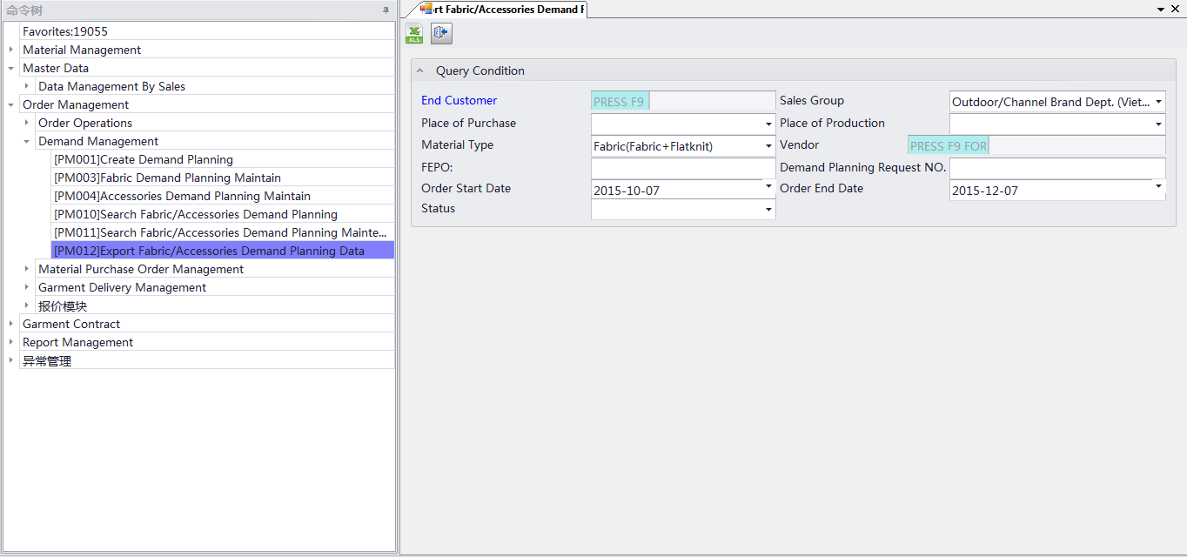
AGP STSTEM
Export fabric/ acc demand planning data ：order management →demand management →
Export fabric /acc demand planning data
Click để down file excel

