Slide 1
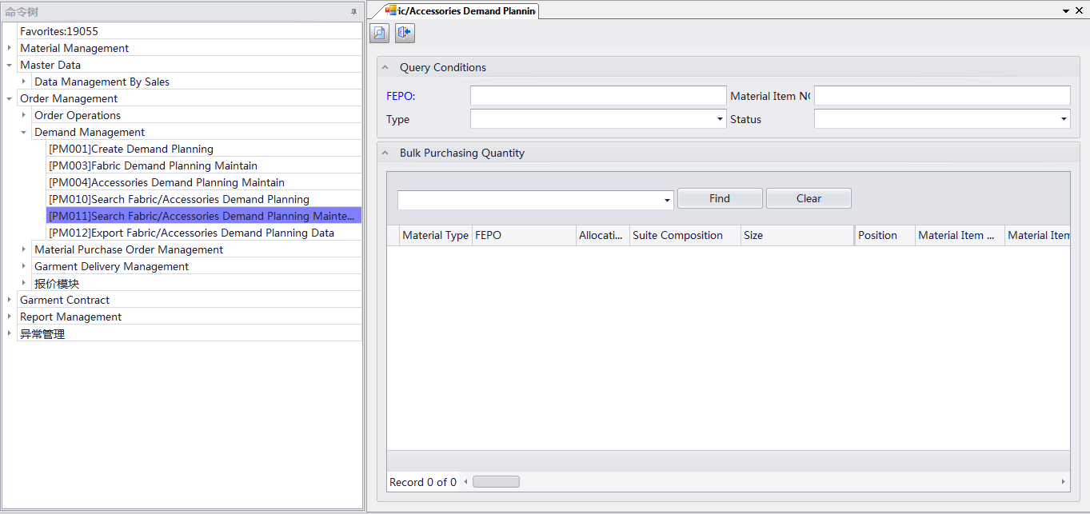
AGP SYSTEM
Search fabric/acc demand planning maintain ：order management →demand management →search fabric /acc demand planning maintain

